Slide 1
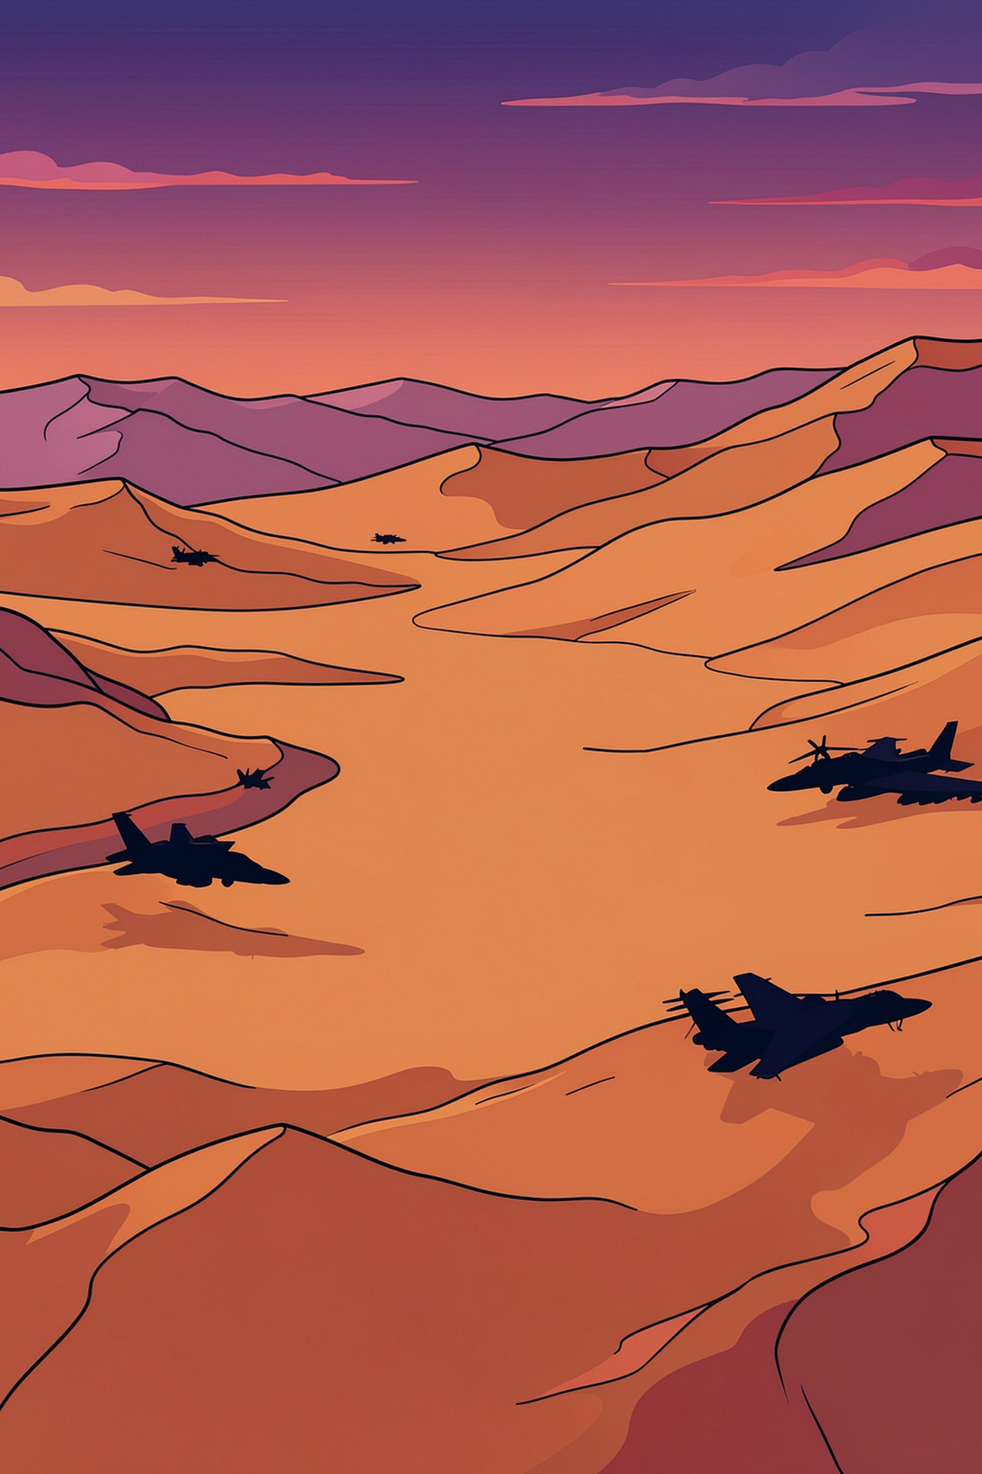
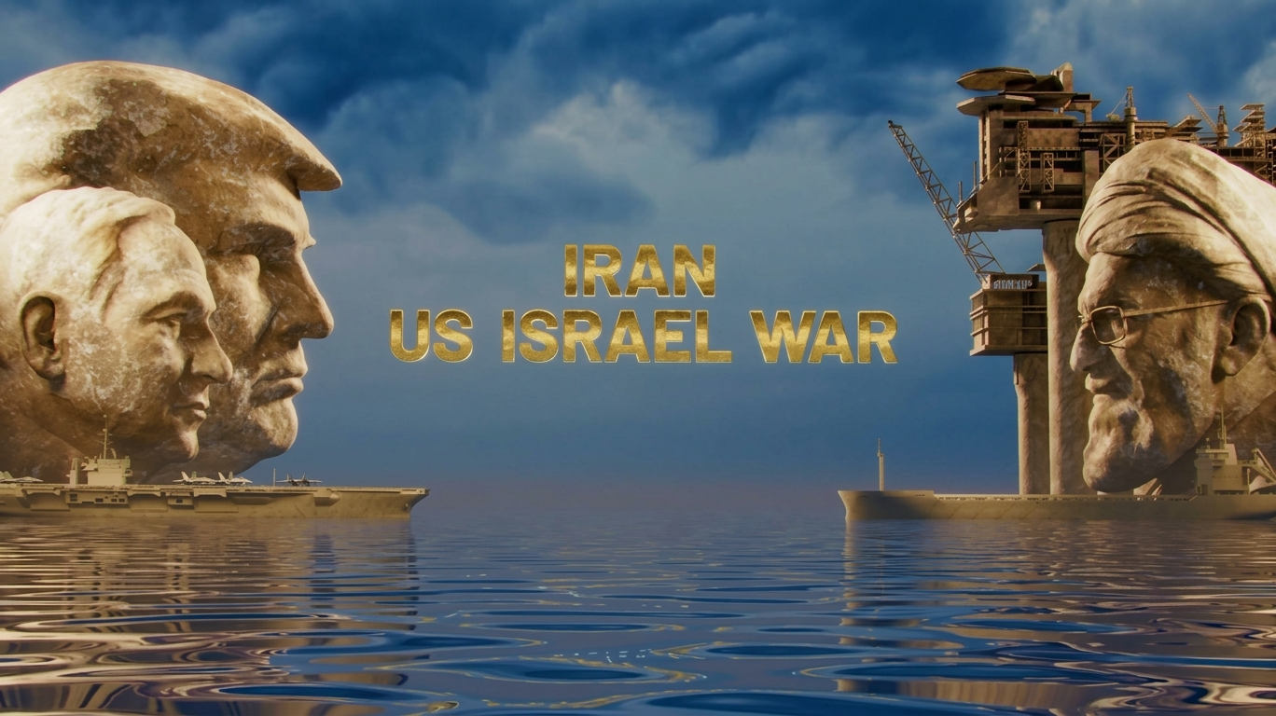
The 2026 Iran War
01 / 09
Himanshu Bist Presents:
-
IRAN–ISRAEL CONFLICT · MIDDLE EASTERN CRISIS
Subject Teacher :
Mr. Aujee
Section : Tesla

Slide 2
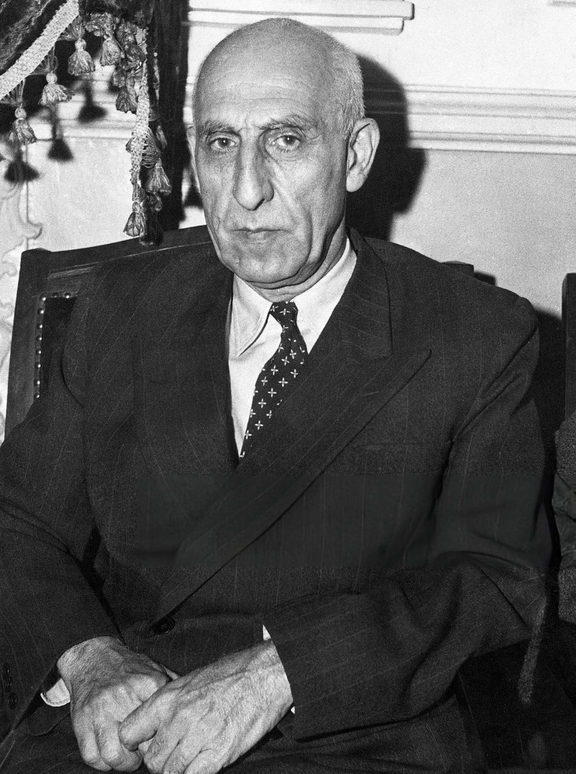
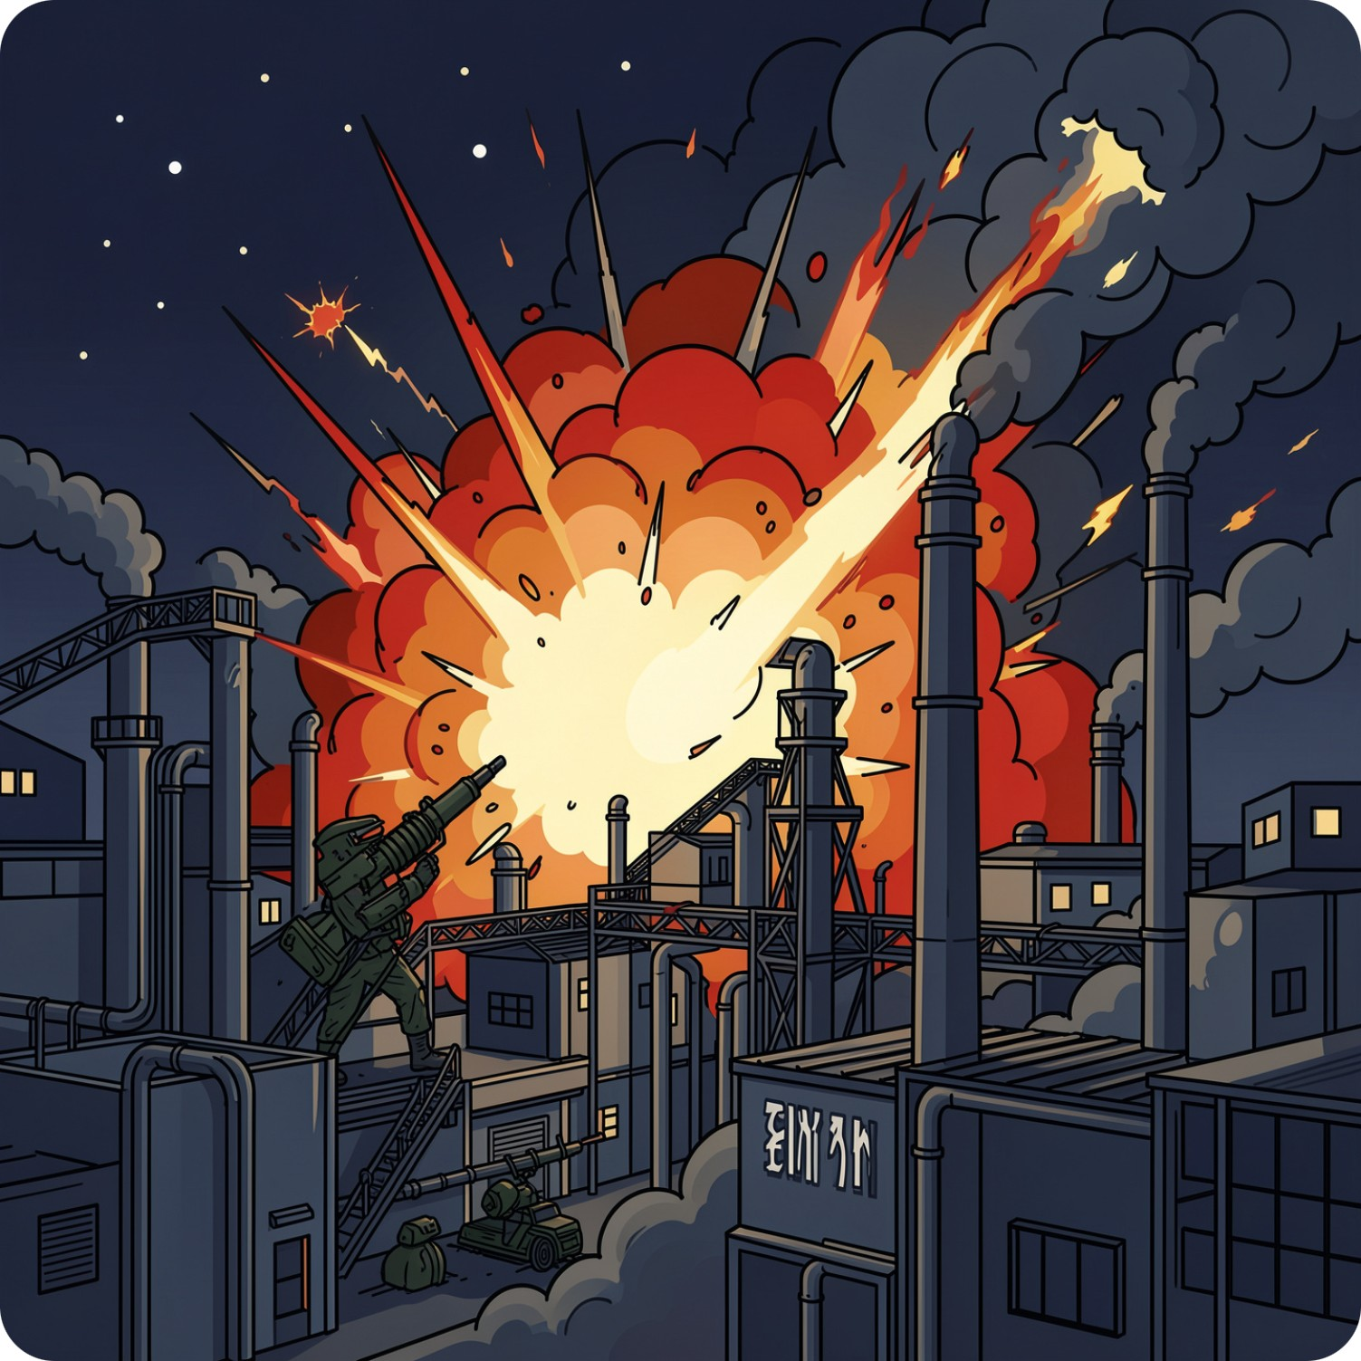
02 / 09
BACKGROUND
1941 – Operation Countenance: Anglo-Soviet forces invade Iran to secure
oil fields and open the Persian Corridor
supply route to the USSR.
1945–1950s – Petro-Security Alliances: U.S. establishes security-for-oil
agreements across the Middle
East, anchoring oil sales to
U.S. dollar in exchange for military
protection.
1951 – Oil Nationalization: Prime Minister Mohammad Mossadegh
nationalizes Iran's oil industry, breaking British
oil concessions.
1953 – Operation Ajax (Coup): U.S. and British intelligence overthrow
Mossadegh, reinstating the US Puppet
Shah Mohammad Reza Pahlavi and securing
Western oil and nuclear agreements for
electricity.
Chain of the current War
Mohammad Mossadegh
PM of Iran (Tenure: 1950 to
1953)

Slide 3
03/ 09
BACKGROUND
Decades in the Making
1968 Iran Signs Non-Proliferation Treaty (NPT)
Committing to peaceful civilian nuclear use under
IAEA monitoring
US–Iran tensions over nuclear power and regional influence, 1953–2026
1979 – The Iranian Revolution
Ayatollah Khomeini leads the revolution,
abolishing the U.S. backed monarchy and
ending Western dominance in Iran.
.
2015 JCPA Deal
The Joint Comprehensive Plan of Action, or Iran Nuclear Deal,
was a 2015 agreement that restricted Iran's nuclear program in exchange for sanctions relief. The accord effectively collapsed following the United States' withdrawal in 2018 and officially reached its 10-year expiration date in October 2025.
2025
Iran enriches to 60%; US intelligence
still assesses no active weapons program.
Feb 2026
Geneva talks fail; US and Israel launch coordinated strikes on
Feb 28.

Slide 4
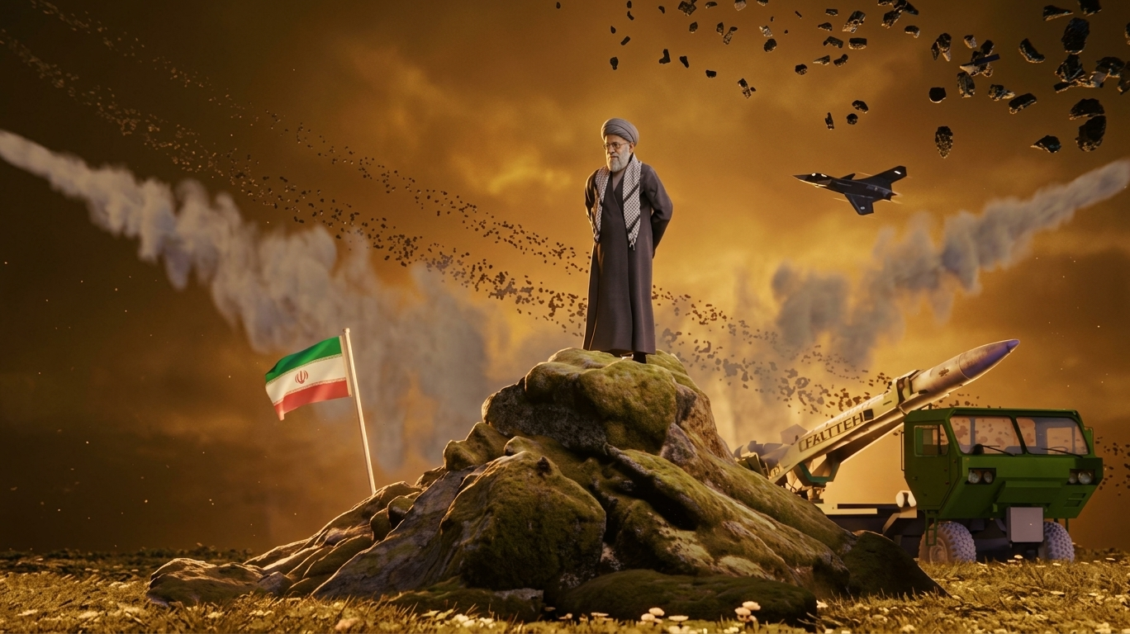
04 / 09
1989–2000S • MODERN ERA
Khamenei Leadership & Regional Forward Defense
IRGC Centralization
Axis of Resistance
Clandestine Enrichment
Empowered Islamic Revolutionary Guard Corps across domestic economy and foreign policy.
Constructed alliance network across Lebanon, Iraq, Syria, and Yemen for deterrence such as Hezbollah, Houthi, Hamas, etc., pulling Israel in the war
Resumed underground uranium enrichment infrastructure in the late 1980s and 1990s.

Slide 5
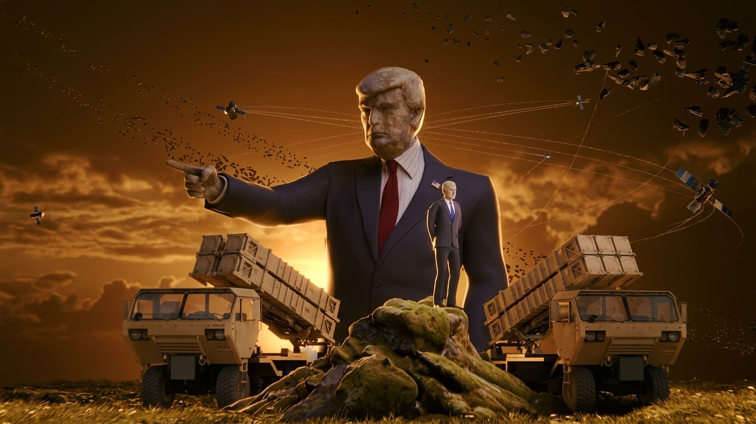
05 / 09
28 February 2026 — The War Begins
900 strikes in 12 hours — US and Israeli forces hit Iranian nuclear sites, missile infrastructure, air defenses, and leadership targets in the opening wave.
Supreme Leader killed — The strikes assassinated Ali Khamenei; his son Mojtaba Khamenei was later named successor.
Talks had just collapsed — The attack came less than two days after indirect US–Iran negotiations in Geneva, mediated by Oman.
Iran retaliates region-wide — Missile and drone strikes hit Israel, US bases, and Gulf Arab states, disrupting Hormuz shipping.
ESCALATION

Slide 6

06 / 09
CASUALTIES
The Human Cost
Reported casualties by 6+ months into the conflict — figures vary by source
3,500+
27,000+
Iranians Killed
Iranians Injured
Per Iran
Per Iran
19
40
US Soldiers Killed
Israeli Soldiers Killed
Per US
Per Israel
31
63
Israelis Killed
US Aircraft Lost/Damaged
Per Israel
Per US
Independent monitors (HRANA, OCHA) report higher Iranian civilian tolls than official figures.

Slide 7
07 / 09
BELLIGERENTS
Two Coalitions
United States, Israel & Partners
Iran & the Axis of Resistance
Core: United States, Israel
Gulf partners: Saudi Arabia, UAE, Kuwait, Bahrain
Also: Yemen (PLC), Iranian separatist groups
Other states engaged: UK, Azerbaijan, Egypt, Iraq, Jordan, Oman, Qatar, Turkey, Syria — diplomatic, basing, or defensive roles
Core: Iran
Axis of Resistance: Hezbollah, Houthis, Amal Movement, Popular Mobilization Forces, Islamic Resistance in Iraq
Also: Hamas, Palestinian Islamic Jihad, PFLP, Islamic Group of Lebanon, Syrian Social Nationalist Party
Additional parties on both sides engaged in diplomatic, basing, or limited defensive roles.

Slide 8
08 / 09
Israel's Undeclared Arsenal & the West Hypocrisy
The only nuclear weapons program in the Middle East, begun in the 1960s with French assistance. Israel maintains deliberate ambiguity — neither confirming nor denying it — and the program remains officially unacknowledged by the US.
Technician Mordechai Vanunu exposed details in 1986 and was severely punished. During the Gaza war, an Israeli minister and MP each referenced the arsenal in relation to Gaza.
While US says Iran’s nuclear program is dismantling peace, it stays at absolute silencese for Israel’s subject of Nuclear Possession. US itself votes in favor of Israel, even using Veto power, protecting its ally at any cost. Irony is that US is the one who legally funds $4B each year in Israeli Defense Force, the bombs which have deliberately killed 177,000 civilians in Gaza, Palestine in 3 years by Israeli military in the name of special military operation, 16,000 in Lebanon in 4 months, and thousands in Syria for the Greater Israel Project.

Slide 9
09/ 09
CONCLUSION
Whose Rules, Whose War
A selective outrage
Nations as tribes with borders
The same institutions that condemned Russia over Ukraine stayed largely silent on Gaza — international law applied as leverage, not principle.
States rarely act as moral agents. They behave as large, organized tribal interests — loyalty to the in-group first, “international law” invoked only when convenient.
Power keeps power
No side is purely just
Superpowers don’t just compete — they suppress smaller states from rising, because a strong rival's ally is a threat to their own position.
Every war has both a devil and a hero, and which one you see depends entirely on which side of the border you were born on.
Attack on Titan's closing lesson: the cycle of hatred survives only because each generation is taught to see itself as the victim and the other as the monster — break the myth, and the war loses its fuel.

Slide 10
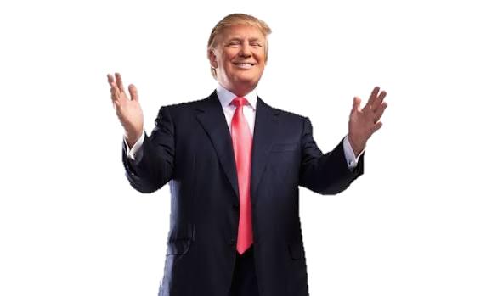
_-_-_-_-_-_-_-_-_-
THANK YOU
Linux Distributions · Computer Science · Grade 11

